Slide 1
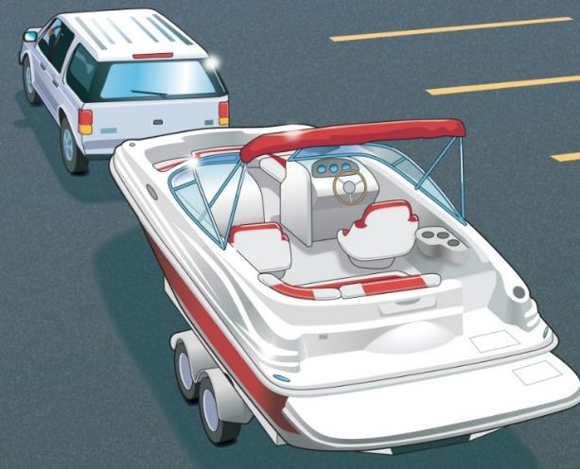
Chapter 2
Before You Get Underway

Slide 2
Key Topics
Boat’s Capacity
Float Plans
Fueling a Vessel and a Personal Watercraft
Trailering/Courtesy on the Boat Ramp
Vessel and Engine Maintenance

Slide 3
Objectives
You should be able to…
Locate and understand a boat’s capacity plate.
File a proper float plan.
Explain how to fuel a vessel safely.
Explain how to launch a vessel from a trailer and retrieve it from the water safely and courteously.
Give the basics of vessel and engine maintenance.
Notes:
Review the objectives of the chapter.

Slide 4
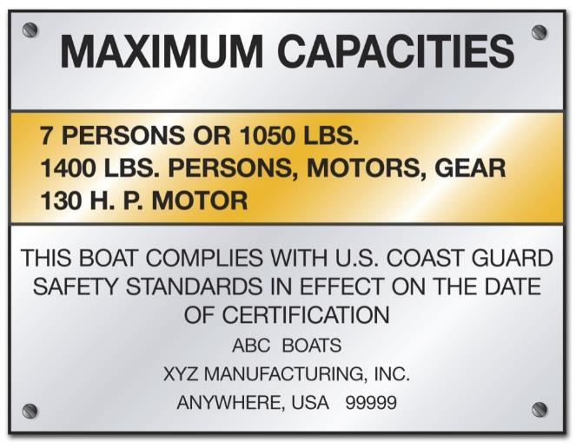
Boat Capacity
Maximum weight includes weight of:
Passengers
Gear
Motors
Notes:
Discuss what the maximum weight includes, not just the weight or number of people. Discuss why being overcapacity is dangerous on the water…balance and stability.

Slide 5
Boat Capacity
Do not exceed the recommended capacity found in the owner’s manual and on manufacturer’s warning decal.
On outboard boats, never exceed the maximum horsepower rating shown on the capacity plate.
On vessels less than 20 feet in length without a capacity plate:
Number of people = vessel length (ft.) X vessel width (ft.)
15
Notes:
If the boat has no capacity plate, or is a smaller vessel, review the formula to determine capacity.

Slide 6
Boat Capacity
Example:
Vessel Length: 18 feet
Vessel Width: 6 feet
Number of people = 18 feet long X 6 feet wide
Number of people = 108
Number of people = 7.2
(no more than 7 people on board)
15

Slide 7
File a Float Plan
For short outings, inform a responsible person of:
WHERE you are boating
WHEN you are returning
WHO to call
Notes:
Talk about why a float plan is important. Tell a family member or friend where you are going and when you should be back. If you are not back in time, call authorities. It is difficult to know where to search for you if no one knows where you went.

Slide 8
File a Float Plan
For extended outings, include:
WHO is going
WHERE you are going
WHAT boat you are in
WHEN you are leaving and returning
Notes:
You should leave a float plan with a friend, family member, close neighbor, someone who will care if you do not return on time and call for help. You can leave it with the marina, but marinas often close.

Slide 9
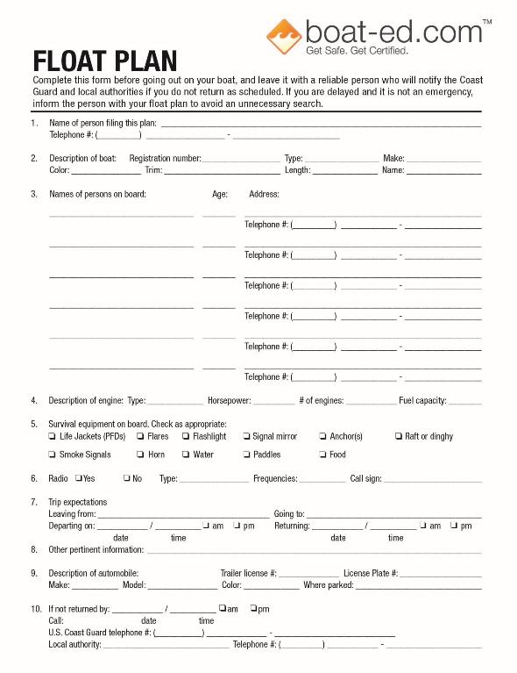
File a Float Plan
Notes:
There several ways to file a float plan. You can use find forms at Boat-ed.com. And at www.floatplancentral.org. Float plans can also be found on the Coast Guard App through your app store for the mobile phone. At the very least, write your information and boat description on a piece of paper and give it to someone you trust.

Slide 10
Fuel Your Vessel…Safely
Before fueling:
Refuel away from the water.
Tie up the boat.
Unload all passengers.
Turn off all sources that could result in a flame.
Close all windows, ports, and doors.
Unload portable fuel tanks.
Notes:
ASK: What are the safety considerations in fueling a boat
o At the fuel dock?
o At a gas station?
o Using portable gas tanks?
Be sure to close windows, ports, and doors to keep fuel vapors from settling inside the vessel. Vapors are heavier than air and will settle in the bilges.

Slide 11
Fuel Your Vessel…Safely
While filling the fuel tank:
Keep nozzle of fuel-pump hose in contact with tank opening.
Use caution and fill tank slowly.
Never fill tank to brim.
Wipe up any spilled fuel.
Notes:
ASK: What are the safety considerations in fueling a boat
o At the fuel dock?
o At a gas station?
o Using portable gas tanks?

Slide 12
Fuel Your Vessel…Safely
After fueling:
Put fill cap on tightly.
Open all windows, ports, doors, and other openings.
Turn on exhaust blower for four minutes.
Sniff for fuel vapors.
Start engine and reload passengers.
Notes:
After fueling be sore to OPEN windows, ports, and doors in order to air out the boat from any fuel vapors that made it inside, especially in the bilge. If you have a blower, run the blower for at least 4 minutes.

Slide 13
Fuel Your Vessel…Safely
To make sure you do not run out of fuel, use this rule:
One-third to get out
One-third to get back
One-third in reserve
Notes:
Review the one-third rule. Boaters always need to calculate their fuel use. Use one-third of your fuel to get to where you’re going and one-third to get back. Save one-third for emergencies. Changes in tides and winds can mean using more fuel than anticipated.

Slide 14
Fuel Your Vessel…Safely
Fueling Issues for a Personal Watercraft (PWC)
Check fuel system for leaks and inspect connections frequently.
Avoid fuel spills in or near water.
Do not tip PWC to fill all the way up.
After fueling, sniff to check for gas fumes.
Notes:
Always be sure to use your nose and sniff for fuel vapor. It is important to check carefully as your fuel tank is under your seat.

Slide 15
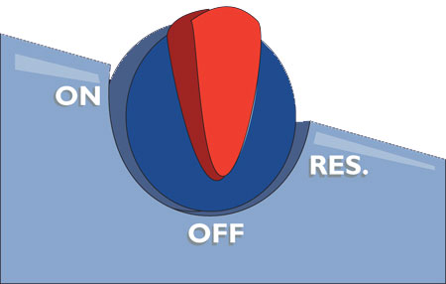
Fuel Selector Switch on a PWC
OFF
ON
RESERVE
Notes:
A PWC should always be aware of the one-third rule as well as any vessel.

Slide 16
Trailering Your Vessel
Choose the Right Trailer & Vehicle to Tow Your Vessel
The trailer and towing vehicle should be designed to fit your vessel.
Use the size of vessel to determine the trailer’s dimensions.
Notes:
Ask: What is the right trailer and the right tow vehicle?
Ask: Why is this an important safety item?

Slide 17
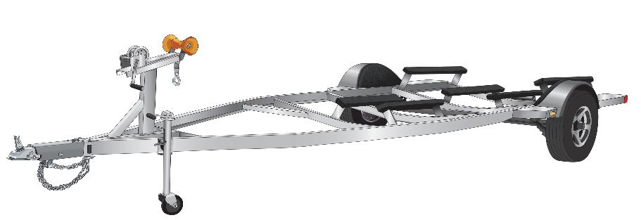
Trailering Your Vessel
Make sure the weight of the vessel and engine does not exceed 90% of trailer’s load capacity. The trailer must carry your:
Vessel
Engine
Fuel
Gear
Notes:
Make sure the class discusses vessel weight, vehicle towing capacity.
Make sure to discuss that the trailer needs to be able to carry the weight of the boat as well as the engine(s), fuel and gear. Tongue weight on the trailer should be 10%.

Slide 18
Trailering Your Vessel
Example:
Vessel Size: 19 feet long
Weight of Vessel: 2600 lbs. (Includes weight of engine, fuel, and gear)
Which capacity trailer would you choose?
2300 lbs.
OR
3000 lbs.
Notes:
Discuss the choice the class should make on this slide and why.

Slide 19
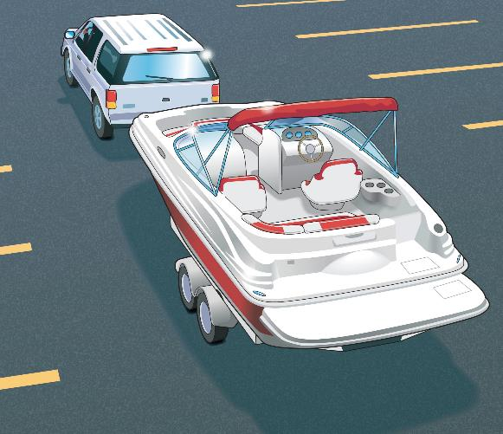
Trailering Your Vessel
Choosing the Right Vehicle
The towing vehicle must be rated to tow the combined weight of:
Vessel
Engine
Trailer
Notes:
Make sure the class discusses vessel weight, vehicle towing capacity.
Make sure to discuss that the trailer needs to be able to carry the weight of the boat as well as the engine(s), fuel and gear

Slide 20
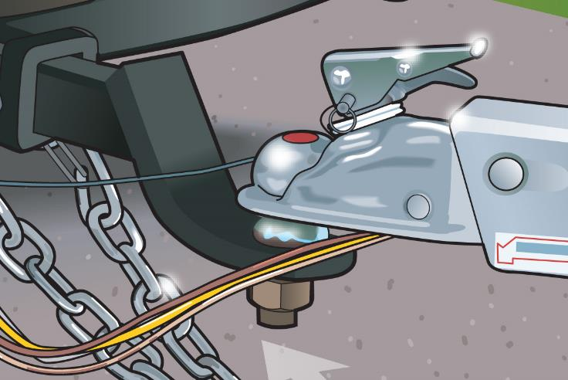
Trailering Your Vessel
Towing hitch must be appropriate for the loaded trailer.
Ball hitch
Coupler
Tongue weight
Notes:
Ball and Tongue must match. Tongue weight should be 10%. In most states chains must be crossed for added safety to keep the tongue from dragging in cade the hitch uncouples.

Slide 21
Trailering Your Vessel
Example:
The trailer for the vessel has a 2 5/16" coupler.
Which of the following sizes of ball hitch must be used on the towing vehicle?
2 ¼"
2 ½"
2 ⁵/₁₆"
2 ³/₈"

Slide 22
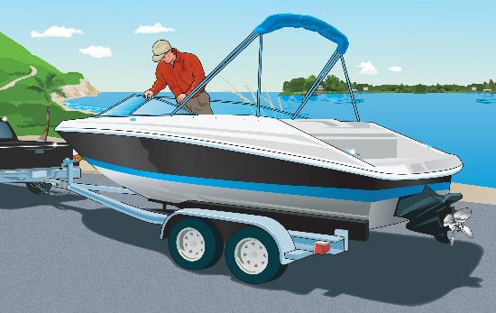
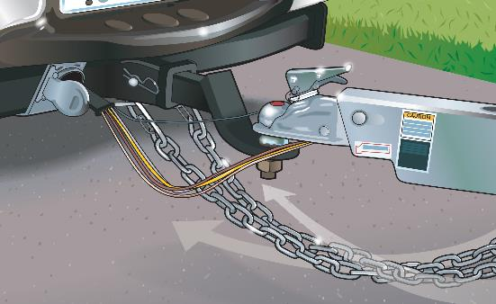
Trailering Your Vessel
Before leaving home:
Secure all gear in the vessel.
Secure the vessel to the trailer.
Secure engine.
Crisscross two safety chains under the trailer tongue.
Notes:
Responses should include:
Secure loose gear
Tie down the boat
Tilt and secure the engine
Inspect the hitch and safety chain
Trailer brakes
Lights
Bearings
Tire pressure

Slide 23
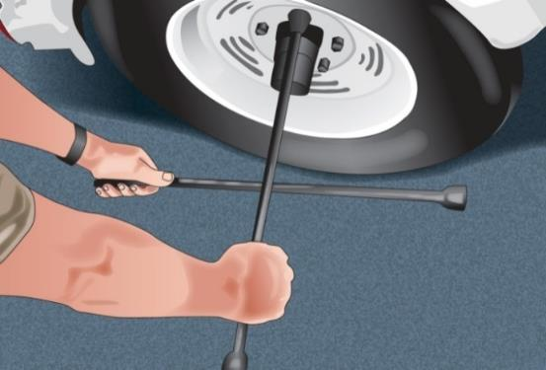
Trailering Your Vessel
Inspect and maintain trailering equipment.
Check tire pressure on all tires.
Tighten lug nuts.
Grease wheel bearings.
Check lights and brakes.
Check tie-down straps, lines, winch, safety chains, and hitch.
Notes:
Discuss the safety importance of these bullet points

Slide 24
Trailering Your Vessel
On the Road With a Trailer
Drive cautiously.
Drive at moderate speeds.
On long trips, pull over every hour or so to check vehicle, trailer, and gear.
Allow for added length and weight of trailer.
Make wider turns at corners and curves.
Allow extra time and distance to stop and pass.
Notes:
Discuss the safety importance of these bullet points

Slide 25
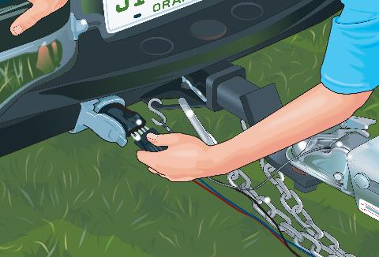
Trailering Your Vessel
Launching Your Vessel From a Trailer
Don’t block ramp traffic!
Transfer all gear to the vessel.
Disconnect trailer lights.
Leave the winch line secured to the vessel.
Remove tie-down straps.
Ensure drain plug is in place.
Tie a rope to the vessel’s bow.
Notes:
Before the bullet points are activated,
ASK: What steps would you go through before launching your boat from the trailer?

Slide 26
Trailering Your Vessel
Back the trailer into the water.
Set the parking brake on the towing vehicle.
Lower the vessel’s engine or outdrive.
Start the engine.
Back the trailer into the water until the vessel floats.
Undo the winch line. Back the vessel off the trailer.

Slide 27
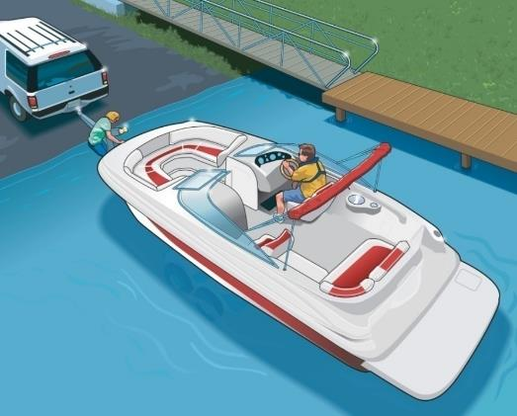
Trailering Your Vessel
Retrieving Your Vessel
Wait for your turn.
Back the trailer into the water.
Set parking brake.
Attach winch line.
Shut off engine.
Raise engine or outdrive.
Pull trailer out of the water.
Notes:
Point out that there is a lot of tension on the winch straps and it’s wise to stay out of the direct line of them.

Slide 28
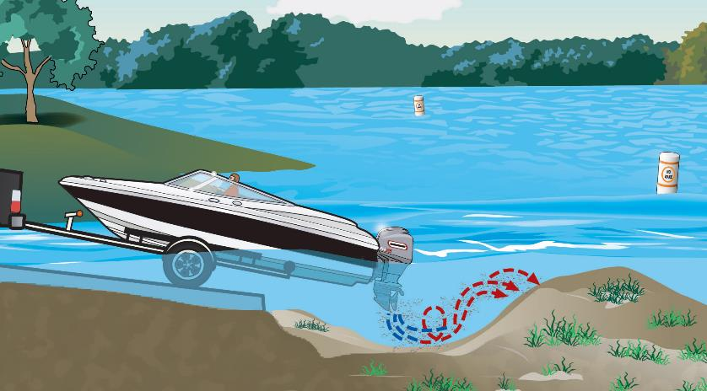
Trailering Your Vessel
Do not power load your boat. Propeller wash can create.
A large hole where trailer tires can get stuck
A mound where boats can run aground

Slide 29
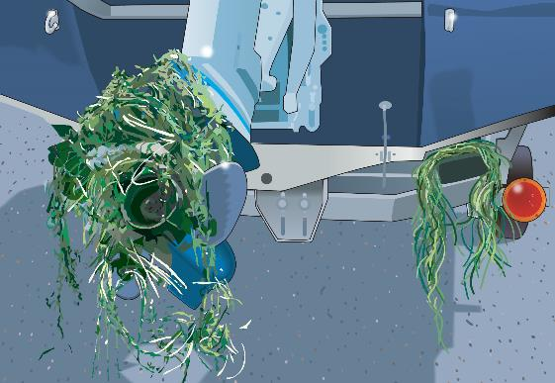
Trailering Your Vessel
Prepare for drive home well away from boat ramp.
Do not block ramp traffic.
Remove and dispose of all aquatic nuisance species.
Remove the drain plug.
Secure your vessel and gear.

Slide 30
Trailering Your Vessel
Courtesy on the Boat Ramp
Prepare your vessel for launching well away from the ramp.
Use at least two experienced people to launch and retrieve.
Never block ramp with unattended vessel or vehicle.

Slide 31
Trailering Your Vessel
When retrieving, do not pull vessel into launch lane until towing vehicle is at ramp.
After retrieving your vessel, pull well away from ramp before preparing for the drive home.

Slide 32
Vessel Maintenance
Examine the hull when it is out of the water.
Store vessels in a dry area out of the sun.
Clean all lines, and keep them out of the sun.
Clean sails, and make repairs.
Follow the maintenance schedule in the owner’s manual.
Notes:
Cleaning the vessel and equipment of attached aquatic plants is necessary to avoid brining non-native invasive species into different waterways. Always remove plants or animals before launching, after loading, after retrieving, before transporting on a public highway. Drain all water from boats, motors, and equipment. Never move live fish away from one water body into another. Dispose of unwanted bait in the trash.

Slide 33
Engine Maintenance
Follow a regular maintenance program.
Keep engine clean and tuned properly.
Check oil and fluid levels before every outing.
Tighten battery connections. Clean battery terminals.
Inspect hoses, belts, and bolts.
Never use automotive electrical parts.

Slide 34
Preventing Theft
Store vessel so it is not easily accessed.
Chain and lock motor and fuel tanks to vessel.
Mark or engrave all equipment.
Photograph or videotape interior and exterior of vessel. Make a complete inventory.
Remove all valuables.
Cover vessel and remove keys.

Slide 35
Chapter 2 Review

Slide 36
Review Exercises
What important safety information is found on the boat’s capacity plate:
a. Minimum number of PFDs required on board.
b. Minimum number of seats required.
c. Maximum weight and/or number of people
the boat can carry.
d. Maximum capacity of fuel tanks.

Slide 37
Review Exercises
To avoid running out of fuel, determine the usable capacity of your fuel tank and your boat’s rate of fuel consumption, and then:
Bring extra fuel in easy-to-store containers such as
plastic milk jugs.
Plan to use 1/3 of the fuel to reach your destination, 1/3 to get home, and 1/3 for emergencies.
Plan on enough fuel to get to the next fuel dock.
Plan on 1/2 your tank to reach your destination and
1/2 to get home.

Slide 38
Review Exercises
Before fueling your boat you should:
Turn off the engine and open all windows, ports, doors, and other openings.
Turn off the engine and close all windows, ports, doors, and other openings.
Turn on the engine and open all windows, ports, doors, and other openings.
Turn on the engine and close all windows, ports, doors, and other openings.

Slide 39
Review Exercises
Where should your trailer be located while you prepare to launch your vessel?:
On your driveway at home.
In front of a vessel being launched.
In the water at the boat ramp.
Well away from the boat ramp.

Slide 40
Review Exercises
Which of these should you leave with a friend or relative before taking your boat on the water?
Float plan for your trip.
Insurance policy.
Operator’s license.
d. Vessel registration.

Slide 41
Review Exercises
It is important that the trailer have sufficient weight-carrying ability to:
Hold the boat, gear, and all passengers in it when on the road.
Keep the trailer on the road surface when traveling at very high speeds.
Carry just the weight of the boat.
d. Support the boat, motor, fuel, and all gear you plan to carry when on the road.

Slide 42
End Chapter 2

